Slide 1
Cyclystic Bike-Share Insights
By: Joseph Gonzalez

Slide 2
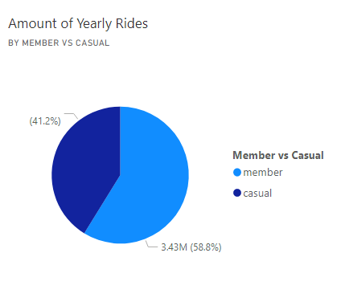
Scenario
In 2016, Cyclistic launched a successful bike-share offering. Since then, the program has grown to a fleet of 5,824 bicycles that are geotracked and locked into a network of 692 stations across Chicago. The bikes can be unlocked from one station and returned to any other station in the system anytime.
Customers who purchase single-ride or full-day passes are referred to as casual riders. Customers who purchase annual memberships are Cyclistic members. Cyclistic’s finance analysts have concluded that annual members are much more profitable than casual riders.
Marketing believes there is a very good chance to convert casual riders into members.
You have been assigned to answer the following question:
How do annual members and casual riders use Cyclistic bikes differently?

Slide 3
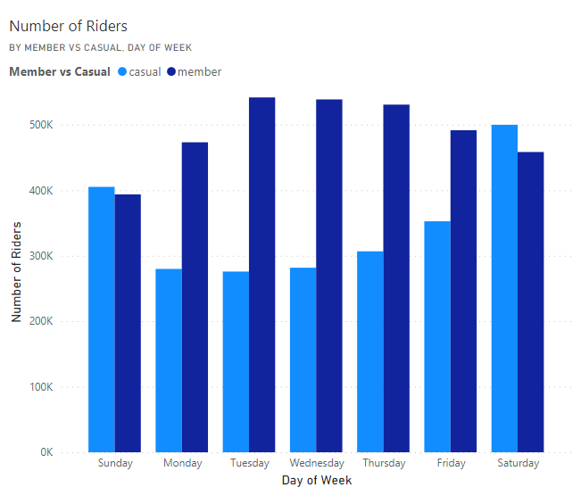
Rides Per Day of Week
Open in Power BI cyclistic visuals Data as of 10/17/22, 8:26 PM

Slide 4
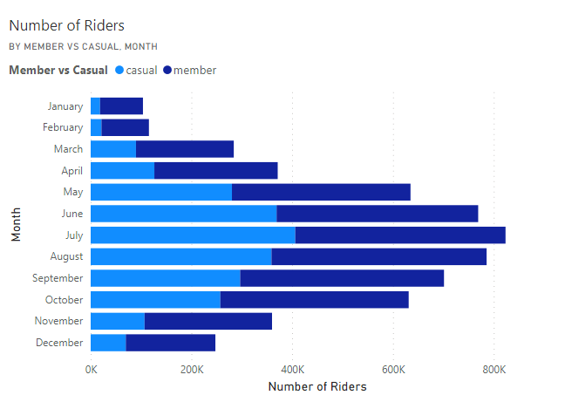
Rides Per Month
Open in Power BI cyclistic visuals Data as of 10/17/22, 8:26 PM

Slide 5
Average Ride Time
Average Member Ride Time
0:12:46
Average Casual Ride Time
0:29:22

Slide 6
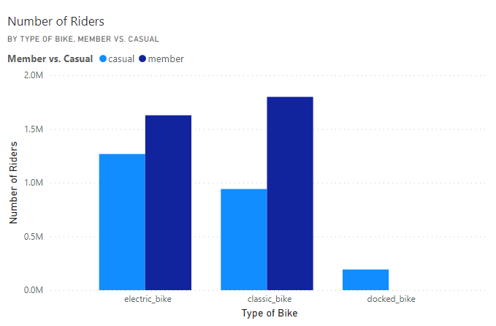
Popular Bike Types
Open in Power BI cyclistic visuals Data as of 10/17/22, 8:26 PM

Slide 7
Summary – Key Findings
Member riders dominate the weekdays whereas on the weekend the numbers tend to be more level leaning slightly toward casual riders. This suggests members use the bikes as a method for their commute to work whereas casual riders use the bikes for leisure.
Reinforcing that belief is the fact that casual riders overall ride time in either day of week or month tend to be longer.
Warmer weather encourages more usage of bikes. Usage of bikes rise dramatically come May and dip back down in October.
Only casual riders use docked bikes.

Slide 8
Recommendations
Riding time limitations for casual riders.
Incorporating membership plans that are exclusive to the warmer months or weekend usage.
Altering payment structures for casuals to be slightly more costly while periodically introducing membership price discounts for new members. Ideas could include a dollar per minute of riding or some sort of minutes a month pricing.
Also, getting rid of docked bikes as no members use them.

Slide 9
Limitations
No age or gender data.
No income data for rider type.
What the current pricing structure of the memberships and casuals are.

Slide 10
Process
Data Source – https://divvy-tripdata.s3.amazonaws.com/index.html
Downloaded files for the last 12 months pertaining to the date I began the project. October 2022
Organized the files into a folder.
Used power query in excel to append all the files from the folder into one file.
With almost 6 million rows it was too much data for a table so only the connection was made.
Columns for calculations mostly pertaining to duration were made.
Power pivot tables and charts were made for calculations and visualizations.
Data was exported to Power BI for remainder of visualizations.

